Slide 1
Random Search Strategies In Herbivores, Carnivores and Omnivores
Michael Bradshaw, Jacob McKean & Chi Huynh

Slide 2
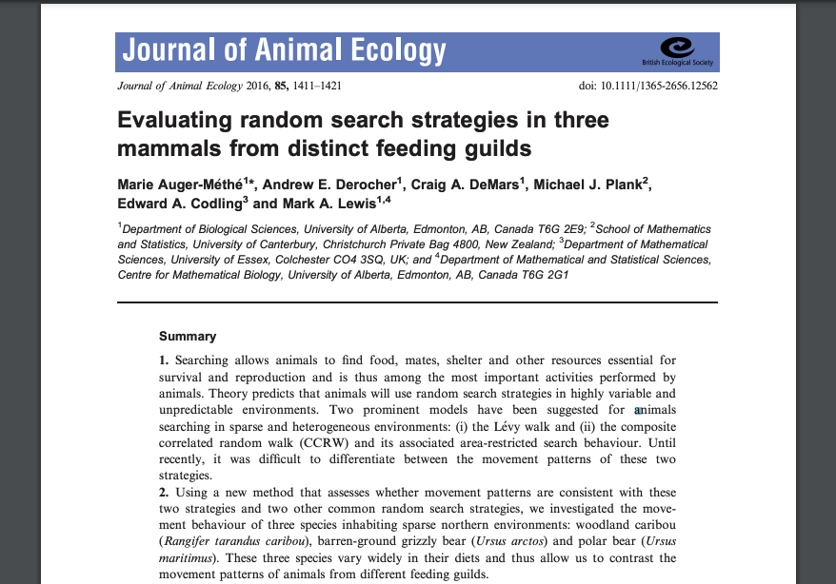
Background
Evaluating random search strategies in three mammals from distinct feeding guilds; Auger-Méthé et al. 2016

Slide 3
Background
“Theory predicts that animals will use random search strategies in highly variable and unpredictable environments.”
“simple Brownian motion may be sufficient in productive areas, the Levy walk may be advantageous in sparse environments because its rare, extremely long steps enable animals to explore new areas”
Barren ground grizzly
Polar bear
Caribou

Slide 4
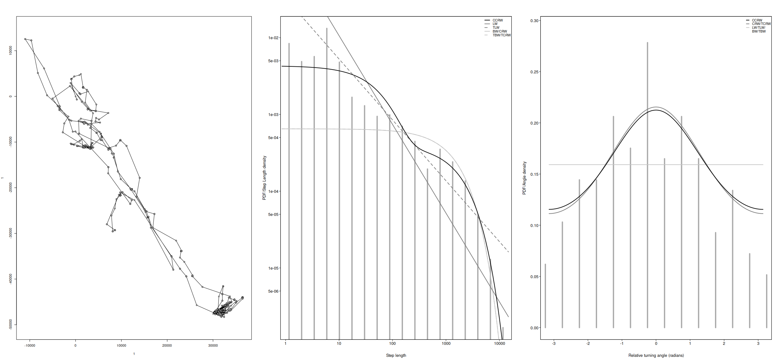
Models
Levy walk
Composite correlated random walk (CCRW)
Auger-Méthé et al. found that CCRW was the most representative because it could model a 2-phase search strategy
Notes:
When sharks and other ocean predators cannot find food, they abandon Brownian motion, the random motion seen in swirling gas molecules, for Lévy flight — a mix of long trajectories and short, random movements found in turbulent fluids.

Slide 5
Do search strategies differ based on diet type?

Slide 6
Our addition
How do animal’s type of diet influence their search strategy?
Plant Eaters
Meat Eaters
Herbivores Omnivores
Carnivores

Slide 7
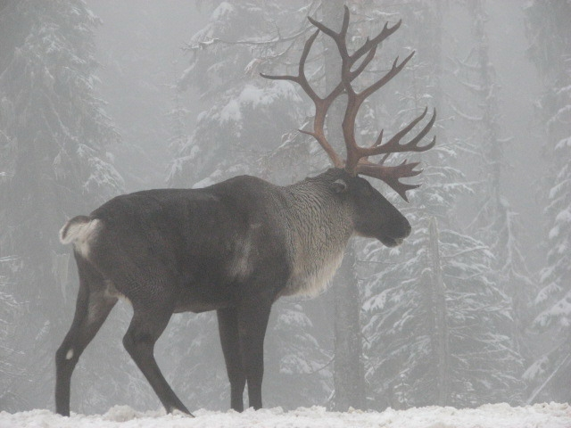
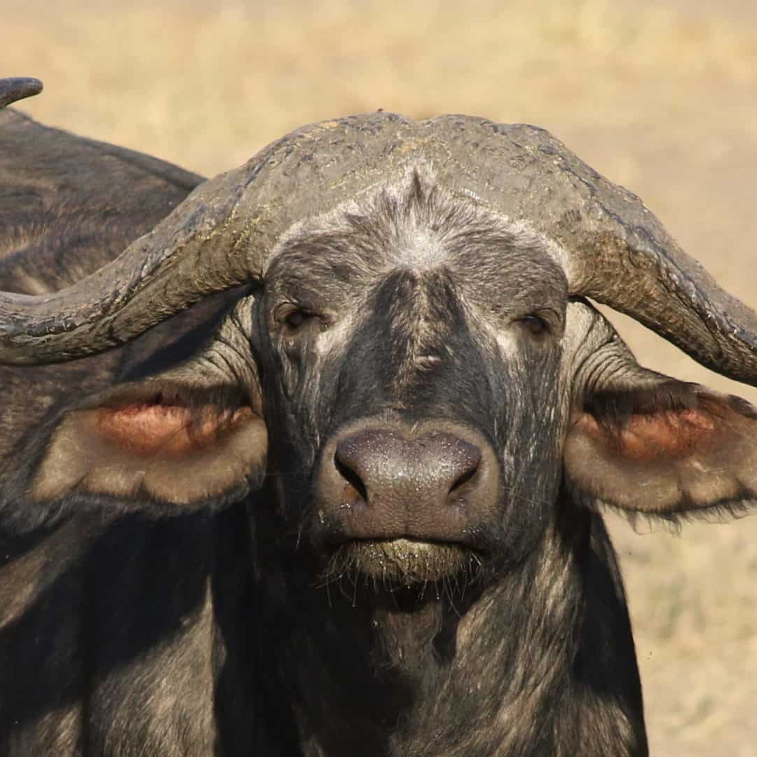
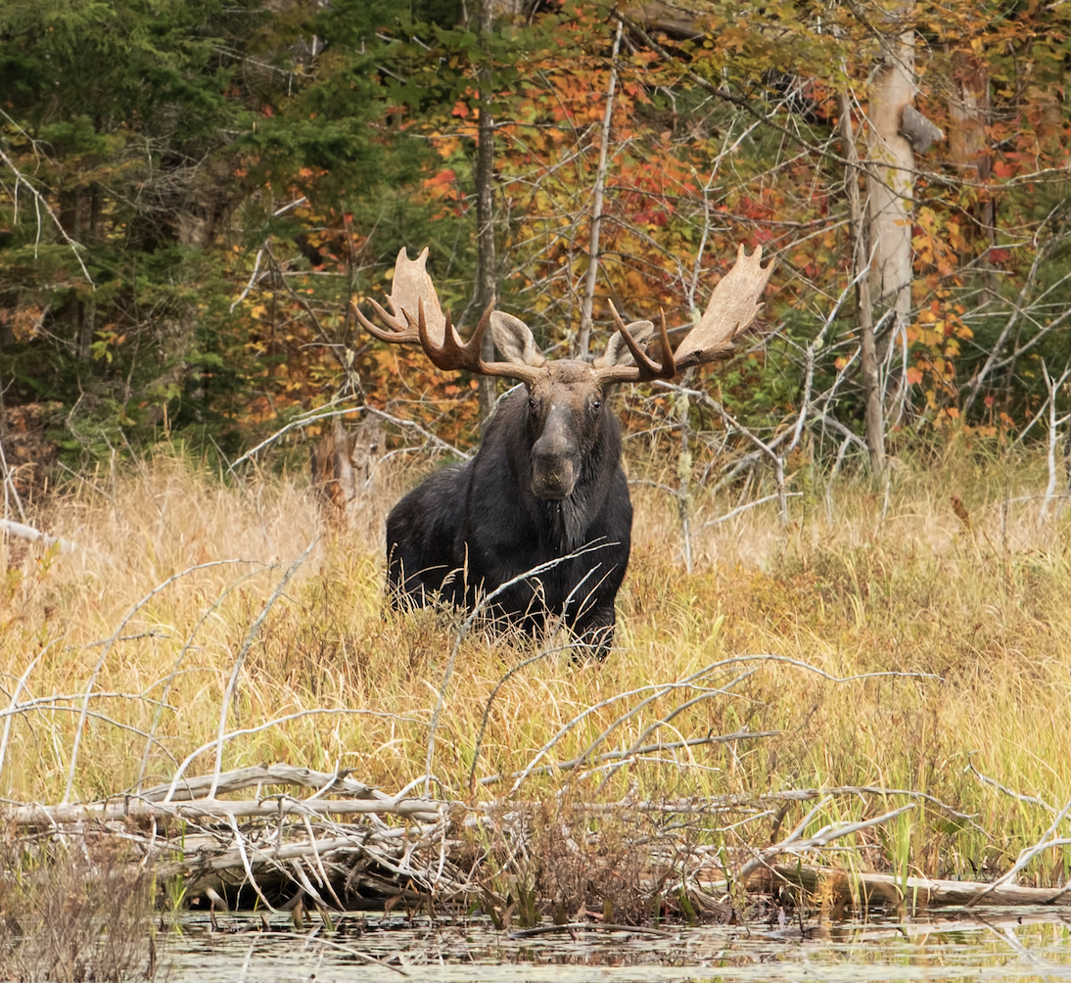
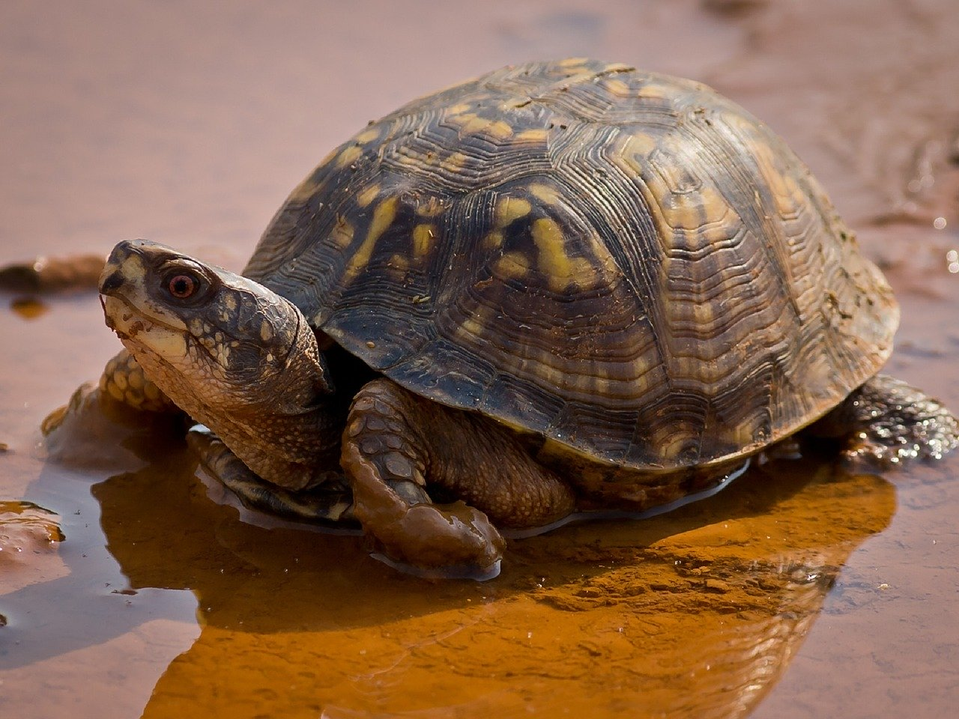
Our addition
How do animal’s diet influence their random walks?
Herbivores:
Woodland Caribou (Paper)
Kruger African Buffalo
Boutin Alberta Moose
Hebblewhite Alberta-BC Moose
Box Turtles (Adults)

Slide 8
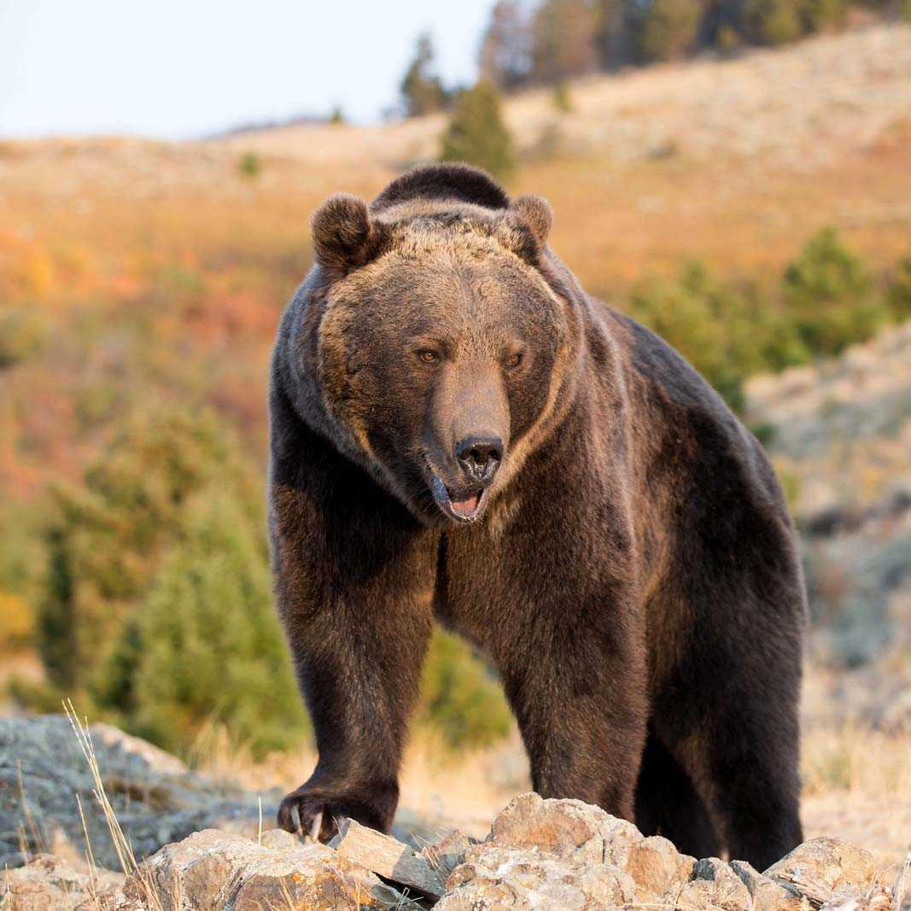
Our addition
How do animal’s diet influence their random walks?
Omnivores:
Barren‐ground Grizzly (Paper)
[ In Progress ]

Slide 9
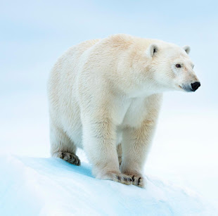
Our addition
How do animal’s diet influence their random walks?
Carnivores:
Polar Bears (Paper)
Box Turtles (Young)

Slide 10
Methods
GPS tracking data
Use Levy walk and CCRW to model the movement of the animals
Compare deal data vs data projected by model

Slide 11
Results

Slide 12
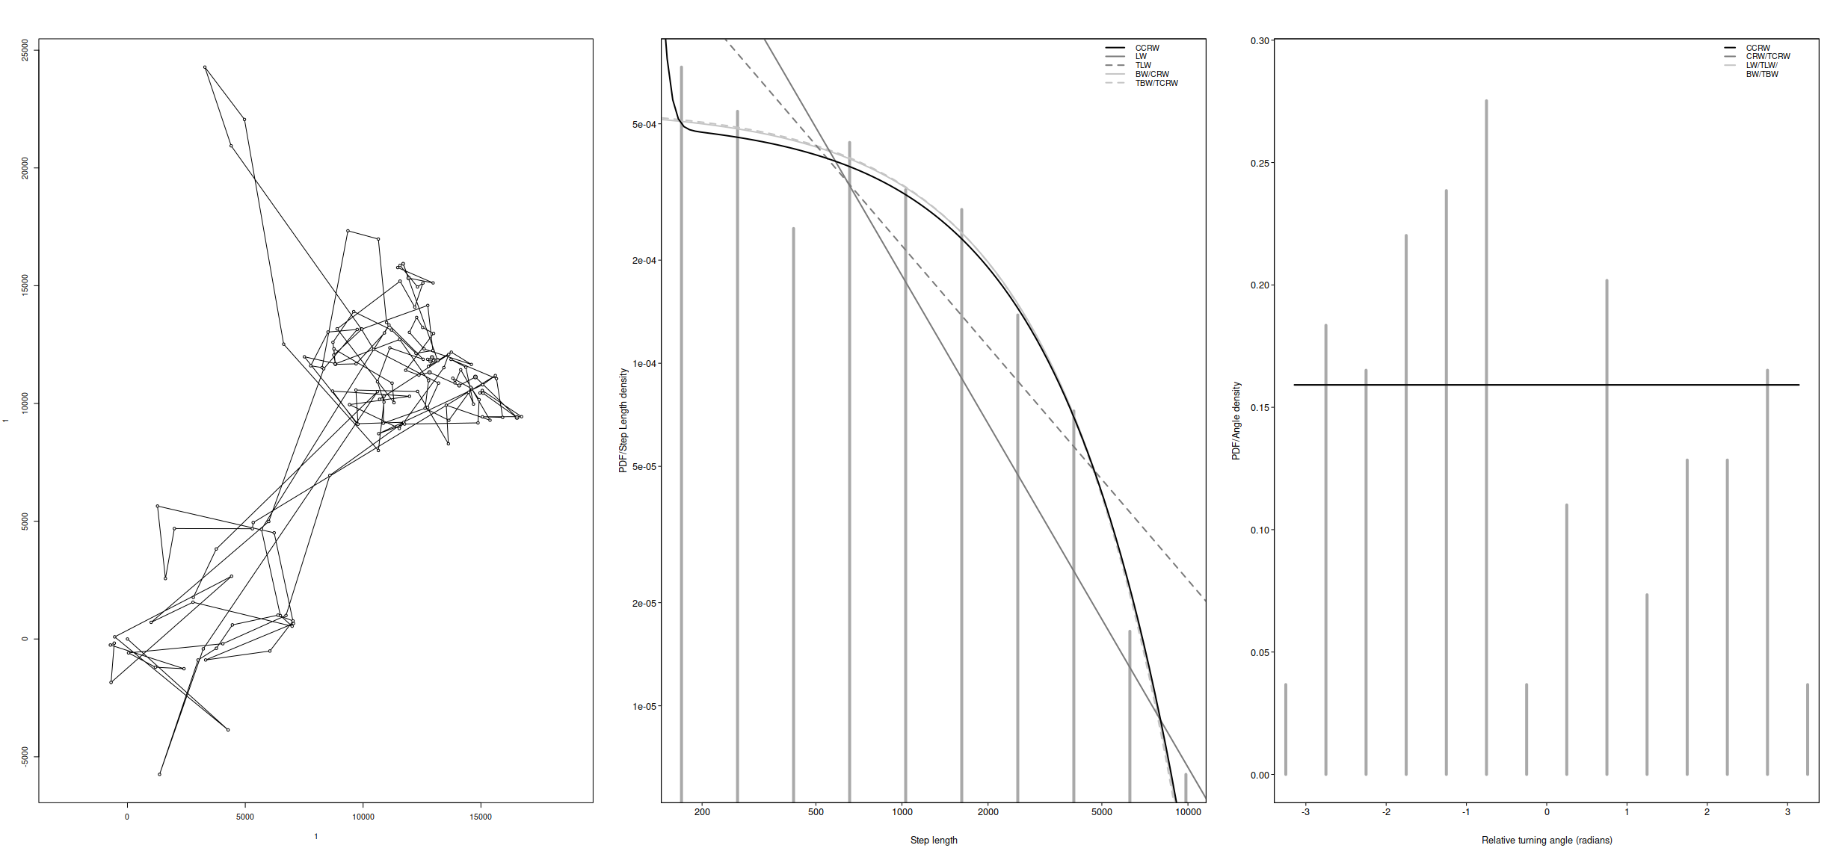
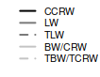
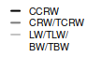
Herbivore: Woodland Caribou
Northing (km)
PDF/Step Length Density
PDF/Angle Density
Easting (km)
Step Length
Relative Turning Angle (radians)
Notes:
https://en.wikipedia.org/wiki/Boreal_woodland_caribou
Data:
Auger‐Méthé, M., Derocher, A.E., DeMars, C.A., Plank, M.J., Codling, E.A. and Lewis, M.A. (2016), Evaluating random search strategies in three mammals from distinct feeding guilds. J Anim Ecol, 85: 1411-1421. https://doi.org/10.1111/1365-2656.12562

Slide 13
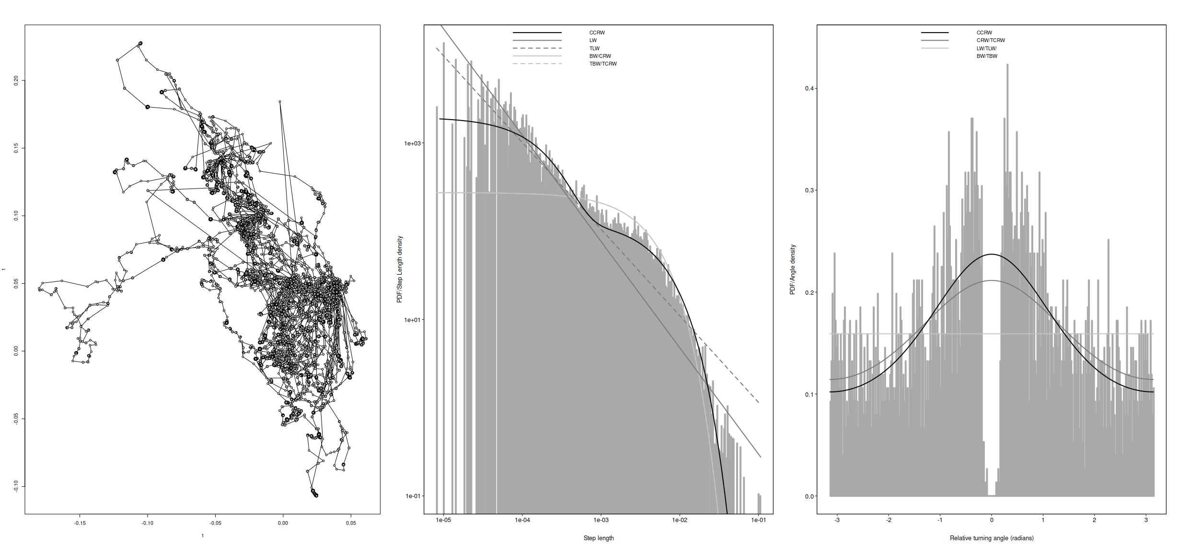
Herbivore: African Buffalo
Northing (km)
PDF/Step Length Density
PDF/Angle Density
Easting (km)
Step Length
Relative Turning Angle (radians)
Notes:
Img source: https://www.kurtsafari.com/the-mighty-cape-buffalo/
Data Source:
Cross PC, Bowers JA, Hay CT, Wolhuter J, Buss P, Hofmeyr M, du Toit JT, Getz WM. 2016. Data from: Nonparameteric kernel methods for constructing home ranges and utilization distributions. Movebank Data Repository. https://www.doi.org/10.5441/001/1.j900f88t
Calabrese JM, Fleming CH, Gurarie E. 2016. ctmm: an r package for analyzing animal relocation data as a continuous-time stochastic process. Methods Ecol Evol. 7(9):1124-1132. https://doi.org/10.1111/2041-210X.12559
Cross PC, Heisey DM, Bowers JA, Hay CT, Wolhuter J, Buss P, Hofmeyr M, Michel AL, Bengis RG, Bird TLF, et al. 2009. Disease, predation and demography: assessing the impacts of bovine tuberculosis on African buffalo by monitoring at individual and population levels. J Appl Ecol. 46(2):467-475. https://doi.org/10.1111/j.1365-2664.2008.01589.x
Getz WM, Fortmann-Roe S, Cross PC, Lyons AJ, Ryan SJ, Wilmers CC. 2007. LoCoH: Nonparameteric kernel methods for constructing home ranges and utilization distributions. PLoS ONE. 2(2):e207. https://doi.org/10.1371/journal.pone.0000207

Slide 14
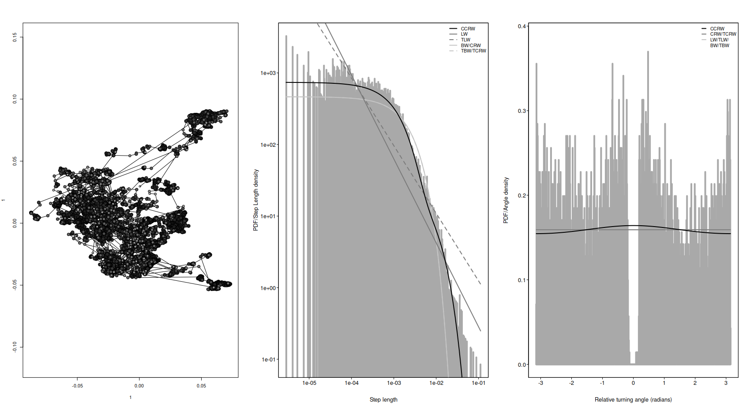
Herbivore: Boutin Alberta Moose
Northing (km)
PDF/Step Length Density
PDF/Angle Density
Easting (km)
Step Length
Relative Turning Angle (radians)
Notes:
Img source: https://www.timberkingoutfitting.com/moose-hunts/
Data source:
Bohm H, Neilson E, de la Mare C, Boutin S (2014) Wildlife habitat effectiveness and connectivity: moose ecology project summary report 2010–2012: Final report. 41 p.

Slide 15
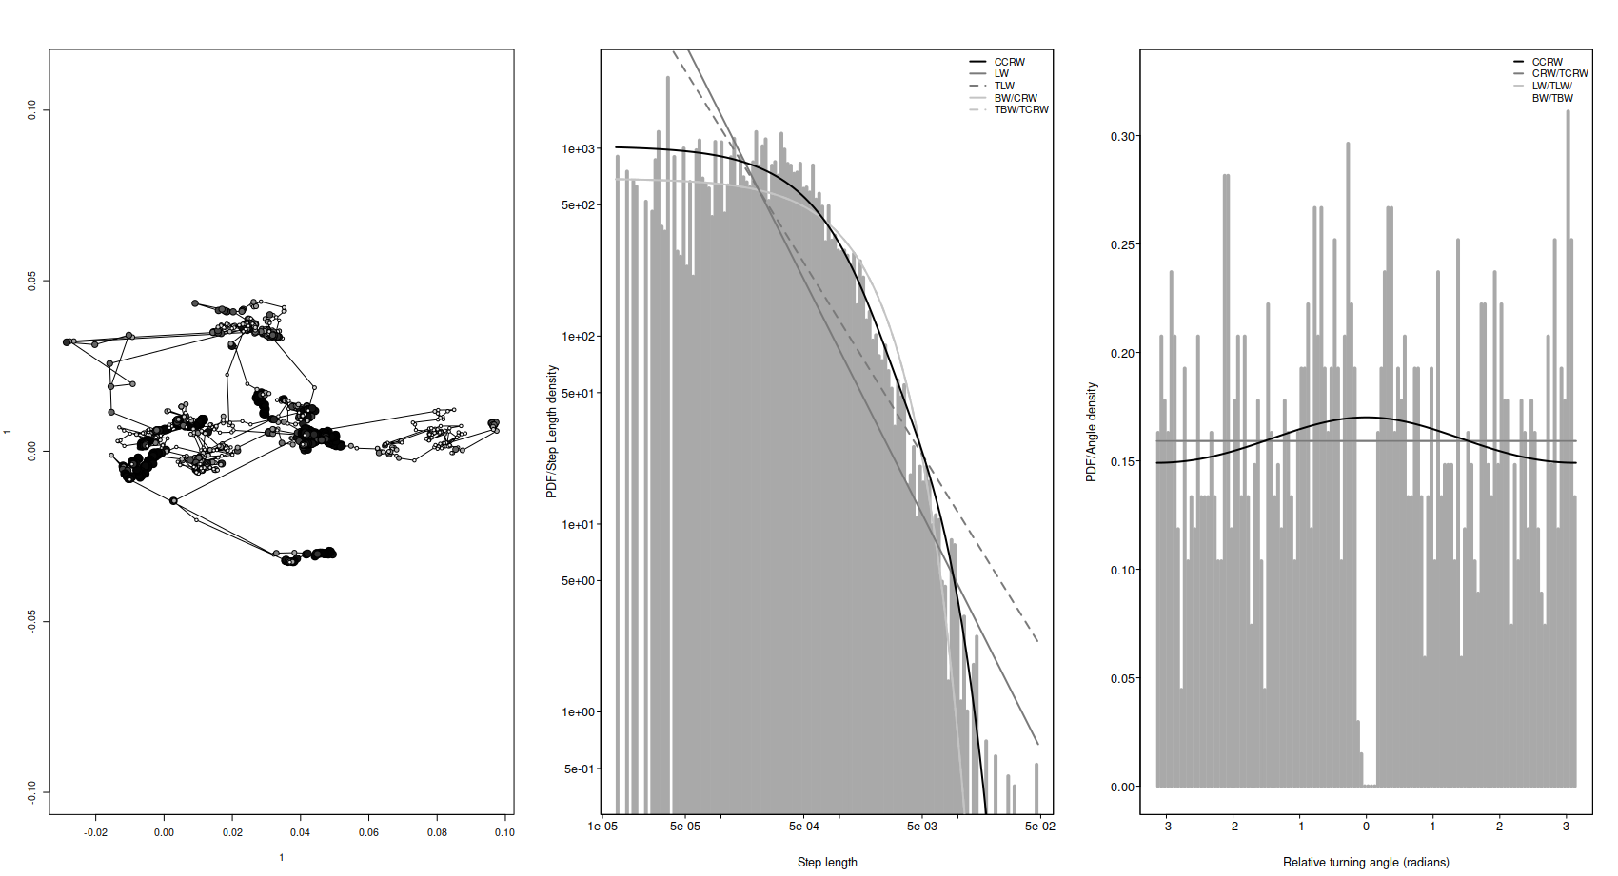
Herbivore: Hebblewhite Alberta Moose
PDF/Step Length Density
Northing (km)
PDF/Angle Density
Easting (km)
Step Length
Relative Turning Angle (radians)
Notes:
Data Source:
Peters W, Hebblewhite M, DeCesare N, Cagnacci F, Musiani M (2013) Resource separation analysis with moose indicates threats to caribou in human altered landscapes. Ecography 36:487-498. doi:10.1111/j.1600-0587.2012.07733.x

Slide 16
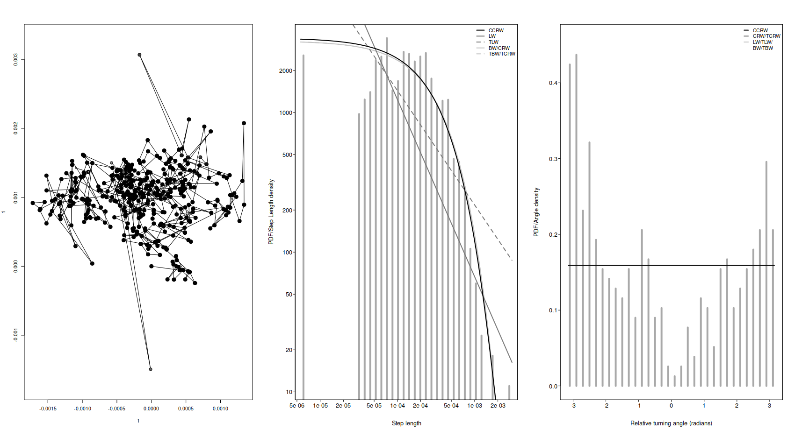
Herbivore: Box Turtle
Northing (km)
PDF/Step Length Density
PDF/Angle Density
Easting (km)
Step Length
Relative Turning Angle (radians)
Notes:
Img Source: https://www.meigspointnaturecenter.org/today-is-eastern-box-turtle-day/
Data Source:
Palmer JL, Brenn-White M, Blake S, Deem SL. 2019. Mortality in Three-Toed Box Turtles (Terrapene mexicana triunguis) at Two Sites in Missouri. Frontiers in Veterinary Science. https://doi.org/10.3389/fvets.2019.00412

Slide 17
Omnivore: Barren-ground Grizzly
Northing (km)
PDF/Step Length Density
PDF/Angle Density
Easting (km)
Step Length
Relative Turning Angle (radians)
Notes:
Img source: https://www.britannic
Data:
Auger‐Méthé, M., Derocher, A.E., DeMars, C.A., Plank, M.J., Codling, E.A. and Lewis, M.A. (2016), Evaluating random search strategies in three mammals from distinct feeding guilds. J Anim Ecol, 85: 1411-1421. https://doi.org/10.1111/1365-2656.12562a.com/animal/grizzly-bear

Slide 18
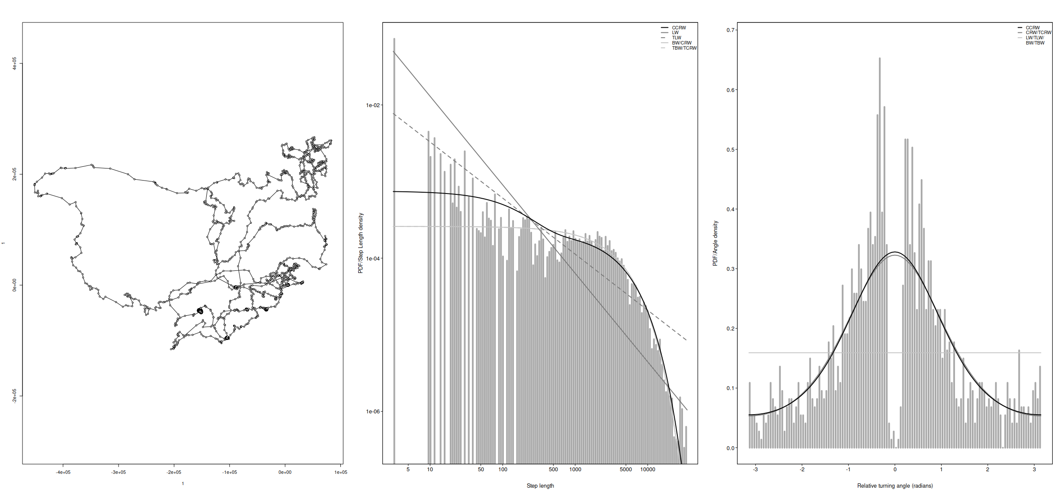
Carnivore: Polar Bear
Northing (km)
PDF/Angle Density
PDF/Step Length Density
Easting (km)
Step Length
Relative Turning Angle (radians)
Notes:
Source img: https://www.worldwildlif
Data:
Auger‐Méthé, M., Derocher, A.E., DeMars, C.A., Plank, M.J., Codling, E.A. and Lewis, M.A. (2016), Evaluating random search strategies in three mammals from distinct feeding guilds. J Anim Ecol, 85: 1411-1421. https://doi.org/10.1111/1365-2656.12562e.org/species/polar-bear

Slide 19
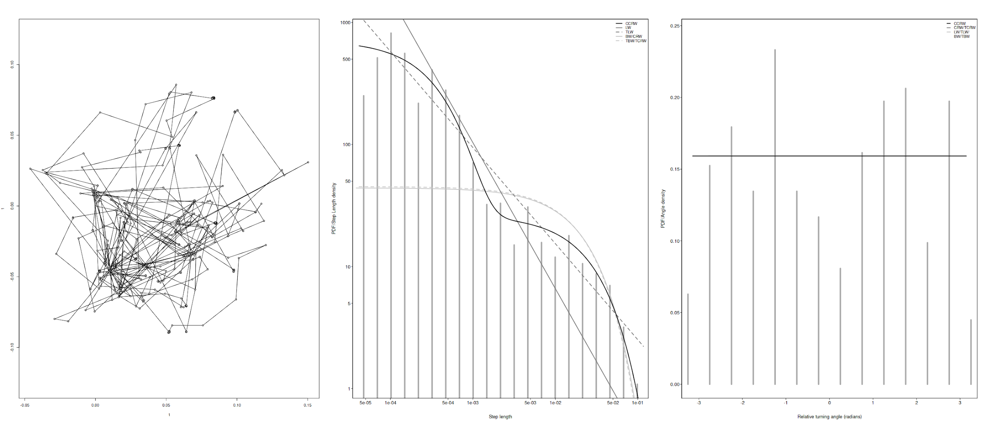
Carnivore: Tsavo Lion
Northing (km)
PDF/Angle Density
PDF/Step Length Density
Easting (km)
Step Length
Relative Turning Angle (radians)
Notes:
Source img: https://www.worldwildlif
Data:
Auger‐Méthé, M., Derocher, A.E., DeMars, C.A., Plank, M.J., Codling, E.A. and Lewis, M.A. (2016), Evaluating random search strategies in three mammals from distinct feeding guilds. J Anim Ecol, 85: 1411-1421. https://doi.org/10.1111/1365-2656.12562e.org/species/polar-bear

Slide 20
Summary Table
 | CCRW | TLW
Herbivores | 5 | 0
Omnivores | - | -
Carnivores | - | -

Slide 21
Conclusion

Slide 22
Conclusion
CCRW models the data the best
TBD if there is a difference between herbivores, omnivore and carnivores

Slide 23
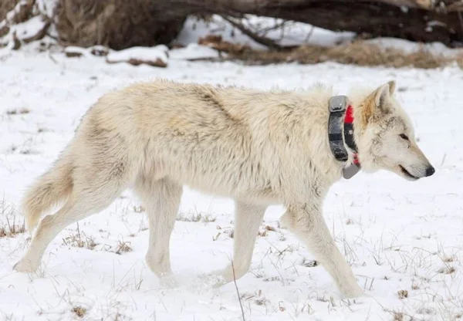
What Makes Data Collection Difficult?
Methods of collection
Spatial Error
Timestep Error
Limitations on usable data

Slide 24
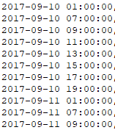
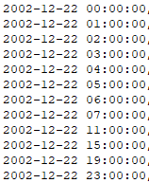
Future Work
Collect more data
Observe other modes of movement; flying, swimming, etc

Slide 25
Sources
Auger‐Méthé, M., Derocher, A.E., DeMars, C.A., Plank, M.J., Codling, E.A. and Lewis, M.A. (2016), Evaluating random search strategies in three mammals from distinct feeding guilds. J Anim Ecol, 85: 1411-1421. https://doi.org/10.1111/1365-2656.12562
Cross PC, Bowers JA, Hay CT, Wolhuter J, Buss P, Hofmeyr M, du Toit JT, Getz WM. 2016. Data from: Nonparameteric kernel methods for constructing home ranges and utilization distributions. Movebank Data Repository. https://www.doi.org/10.5441/001/1.j900f88t
Bohm H, Neilson E, de la Mare C, Boutin S (2014) Wildlife habitat effectiveness and connectivity: moose ecology project summary report 2010–2012: Final report. 41 p.
Peters W, Hebblewhite M, DeCesare N, Cagnacci F, Musiani M (2013) Resource separation analysis with moose indicates threats to caribou in human altered landscapes. Ecography 36:487-498. doi:10.1111/j.1600-0587.2012.07733.x
Palmer JL, Brenn-White M, Blake S, Deem SL. 2019. Mortality in Three-Toed Box Turtles (Terrapene mexicana triunguis) at Two Sites in Missouri. Frontiers in Veterinary Science. https://doi.org/10.3389/fvets.2019.00412

